Slide 1
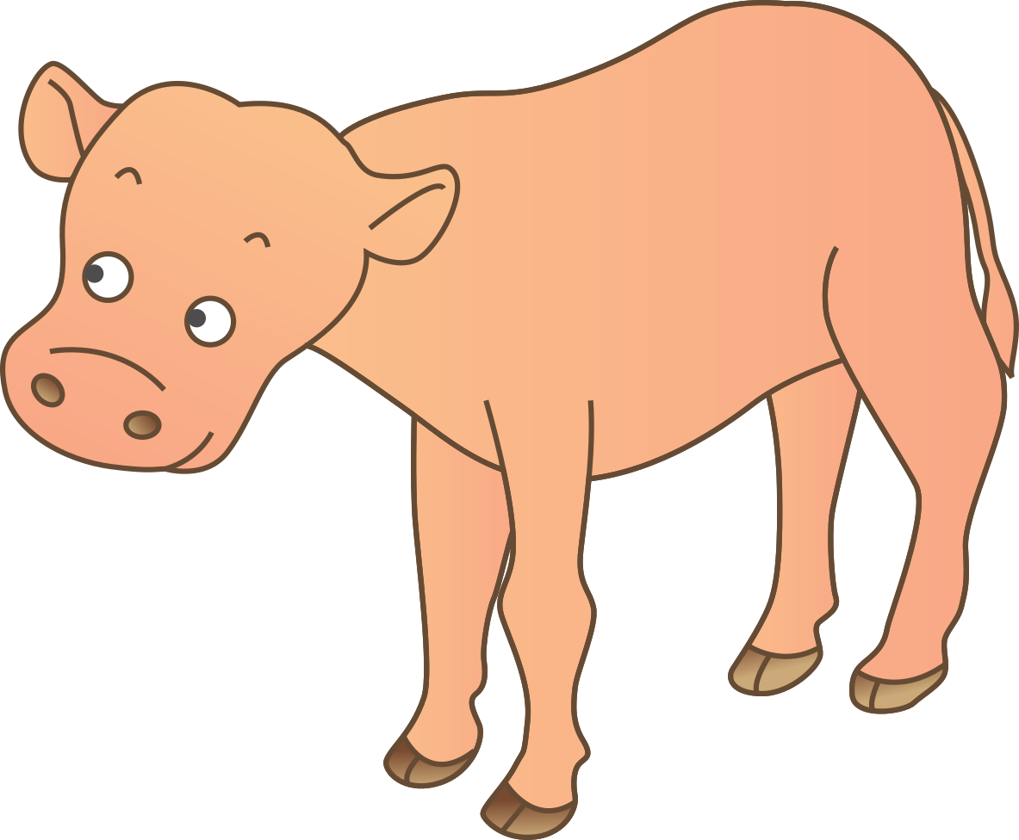
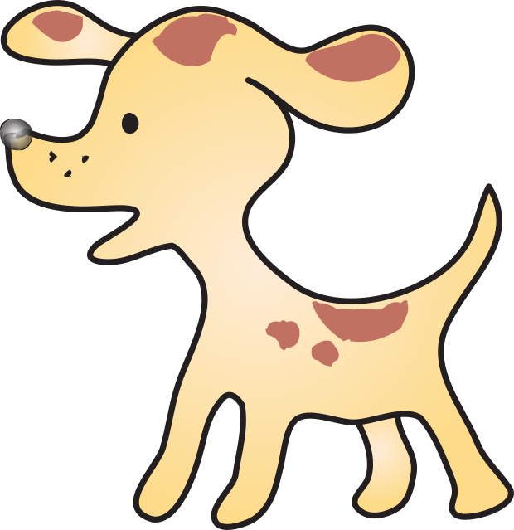
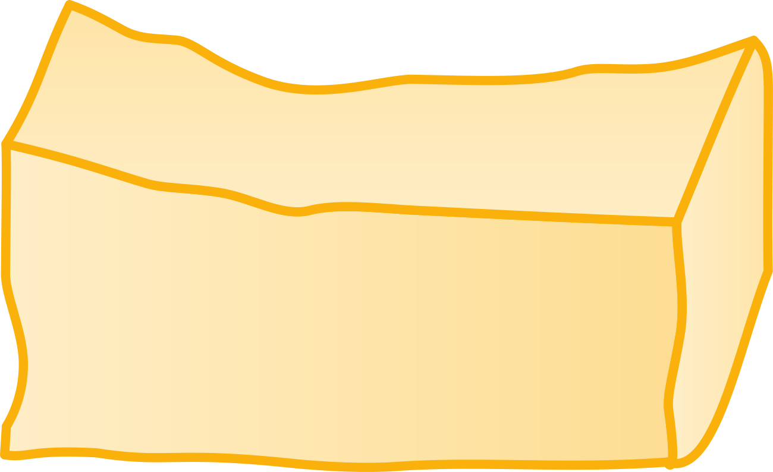
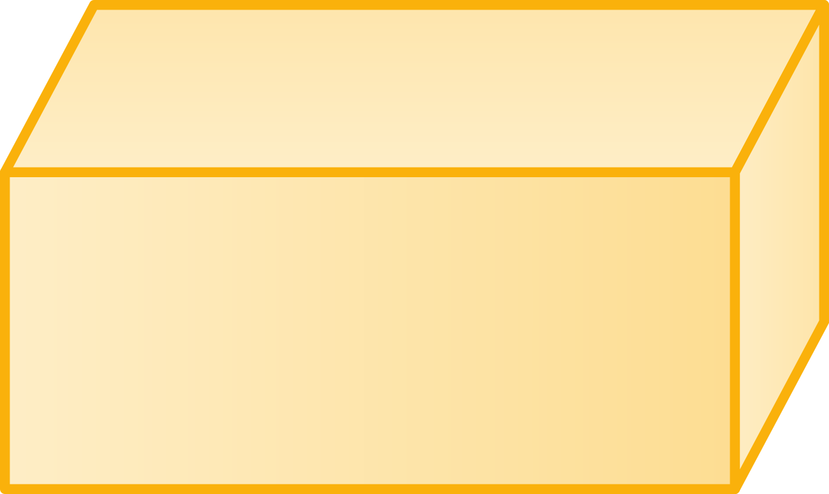
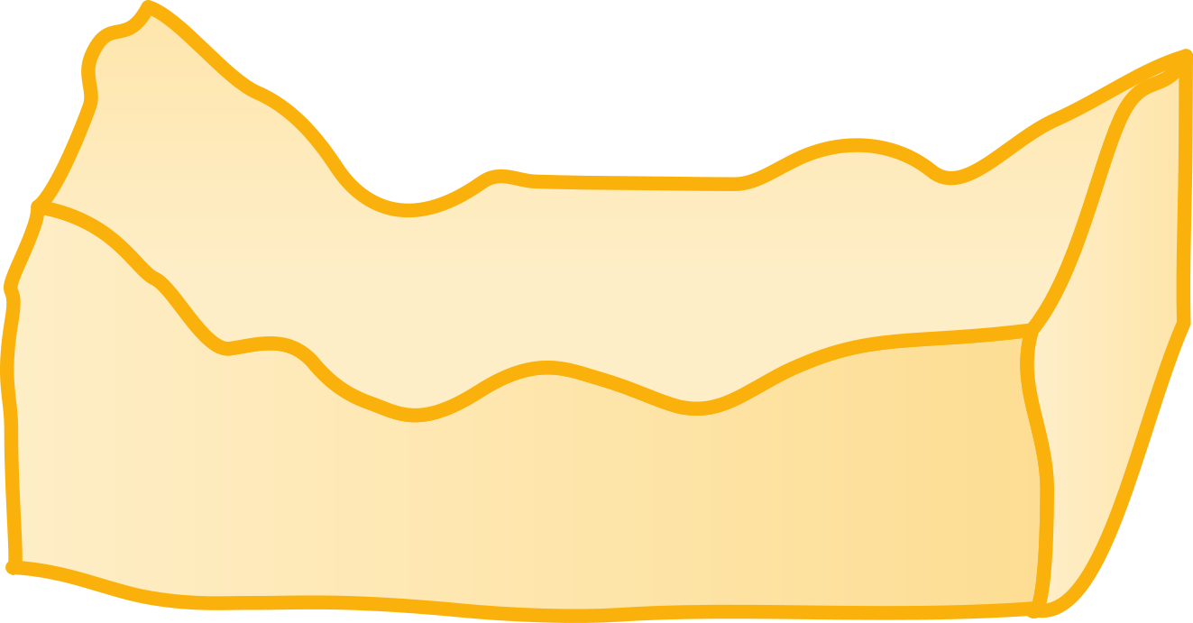
동물을 같은 상자 위에 올려서 어떤 동물이 무거운지 알아보세요.
#5
#2
#3
#6
#4
#7
Notes:
1) (narration plays) 동물을 상자 위에 올려서 어떤 동물이 무거운지 알아보세요. [soundtrack: M3-16-1-2-s001]
2) #3 arrow is blinking until users touch #2 image
3) when users drag #2 image to #4 image , #3 fades out (disappears) and #4 images changed crumpled box. (1)
4) #6 arrow is blinking until users touch #5 image
5) when users drag #5 image to #7 image , #6 fades out (disappears) and #7 images changed crumpled box. (2)
6) conclusion narration plays ** blinking effects according to the narration.
(narration) 상자가 많이 찌그러질수록 동물이 더 무거우므로, 소가 강아지보다 더 무겁습니다. [soundtrack: M3-16-1-2-s002]
(-> image #4(1) & image #7(2) are blinking twice)
-- meaning: since the cow is heavier than the dog, #7 box more crumpled than #4.

